Slide 1
Photo Album
by Home

Slide 2
Anshuman maurya
ADITI MAURYA

Slide 3
My Hero Is Mummy
And Papa
I Love You Mummy
And Dady.

Slide 4
I have learned it.

Slide 5
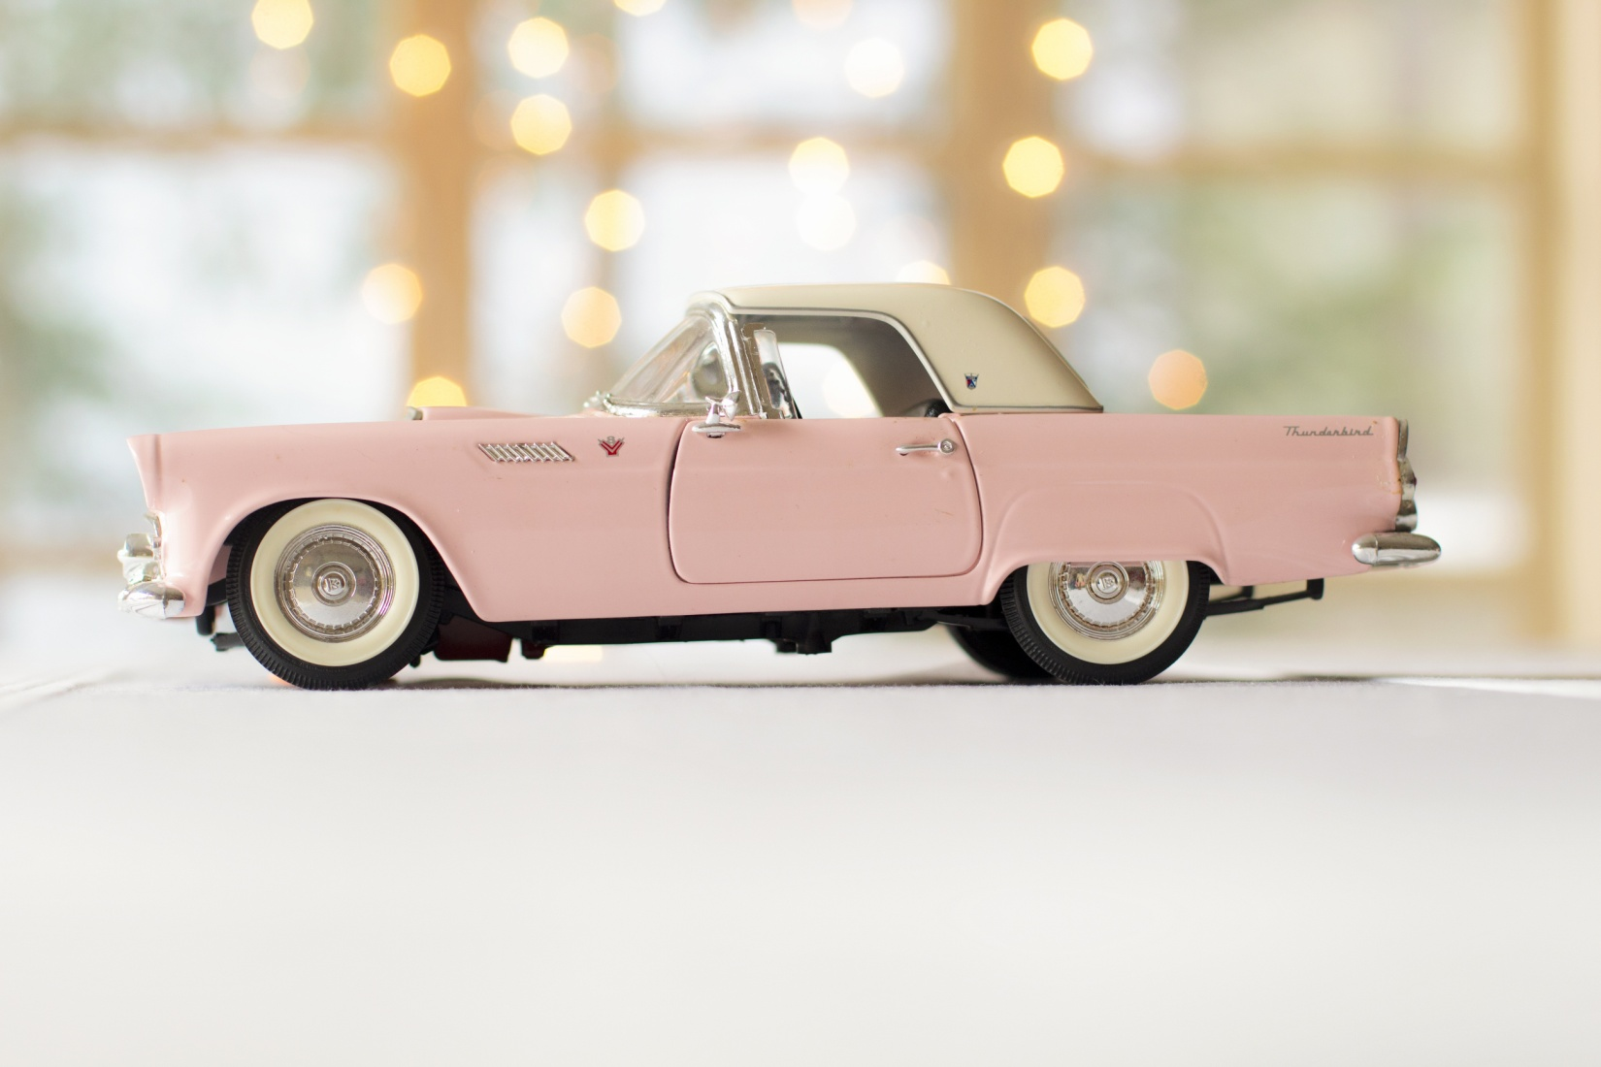

Slide 6
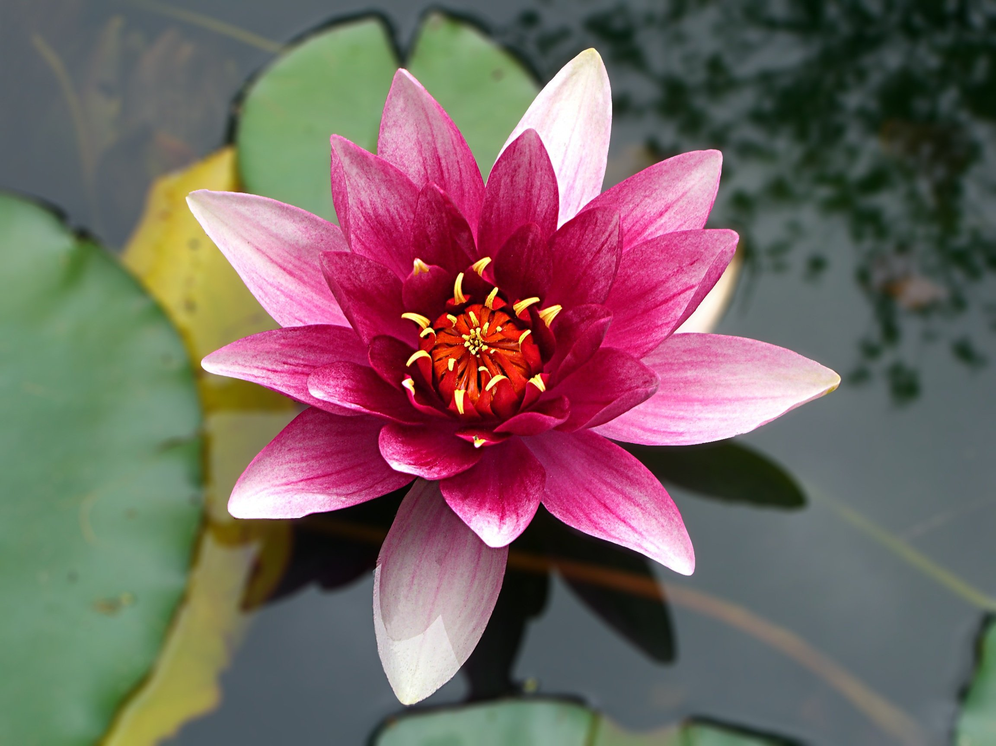

Slide 7
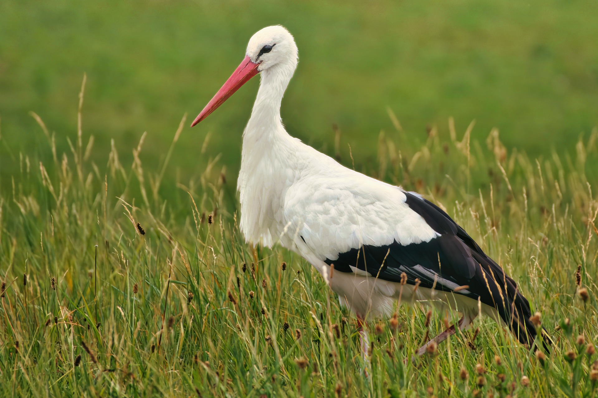

Slide 8
12
9
3
6

